Slide 1
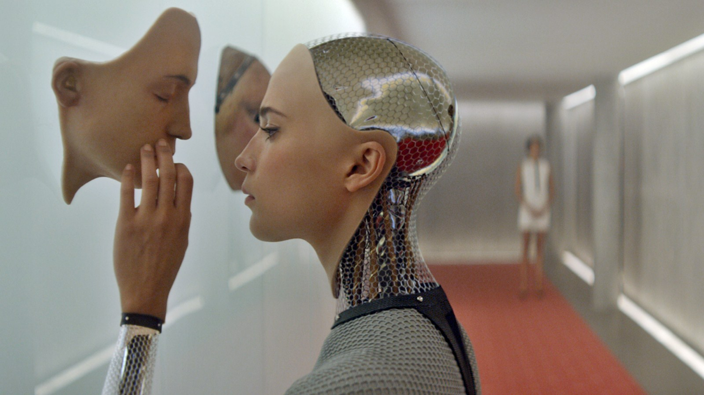
HCI-technologies
Notes:
Lecture 08 May 2019

Slide 2
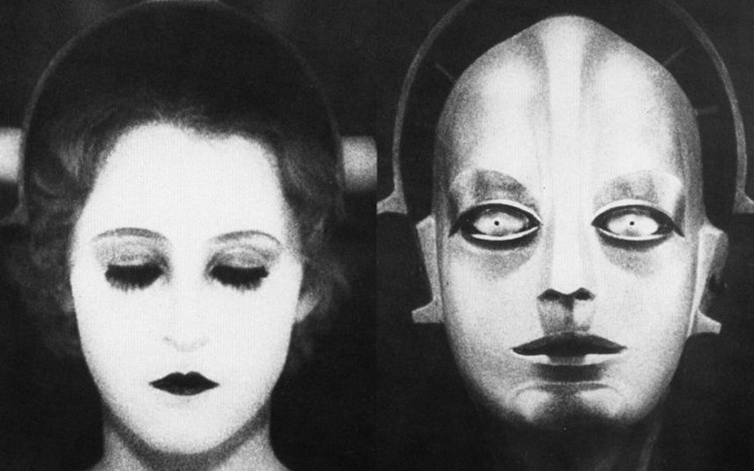
Affective Computing & Artificial Creatures
Chris G. Heydra HCI-technologies 2019

Slide 3
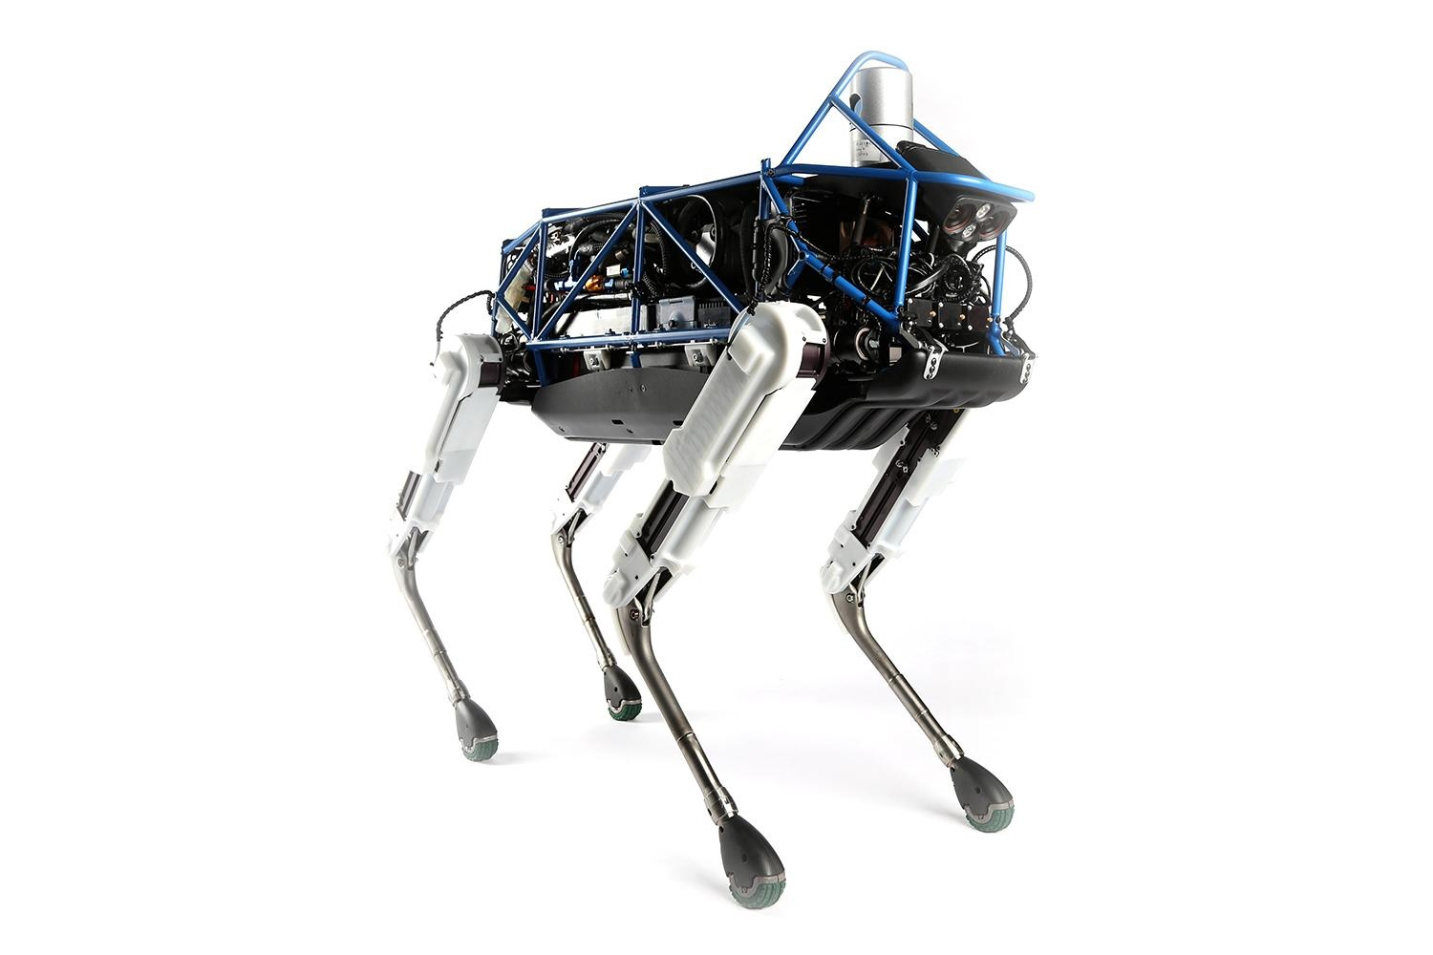
Spot, Boston Dynamics, 2015
Notes:
https://www.youtube.com/watch?v=gstcLQ_LC1g
(niet deze https://www.youtube.com/watch?v=M8YjvHYbZ9w)
Boston Dynamics was founded in 1992 and bought by Google in 2013

Slide 4
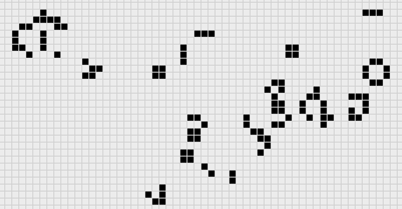
Cellular Automata
Game of life (John Conway, 1970)
1 or 0 neighbour → Death by loneliness.
2 or 3 neighbours→ Stays alive.
4 or more neighbours→ Death by overpopulation
Empty cell with three neighbours spawns new life.
Processing: File > Examples > Topics > Cellular Automata> GameOfLife
Notes:
https://www.youtube.com/watch?v=C2vgICfQawE (starts at 1:08)
Interview with John Conway himself (what a hero)
https://www.youtube.com/watch?v=R9Plq-D1gEk

Slide 5
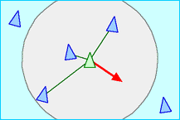
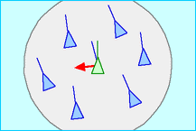
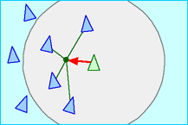
Cellular Automata
Boids
Craig Reynolds (1987)
Separation
Allignment
Cohesion
Processing: File > Examples > Topics > Simulate > Flocking
Notes:
Separation: steer to avoid crowding local flockmates
Alignment: steer towards the average heading of local flockmates
Cohesion: steer to move toward the average position of local flockmates
http://www.red3d.com/cwr/boids/

Slide 6
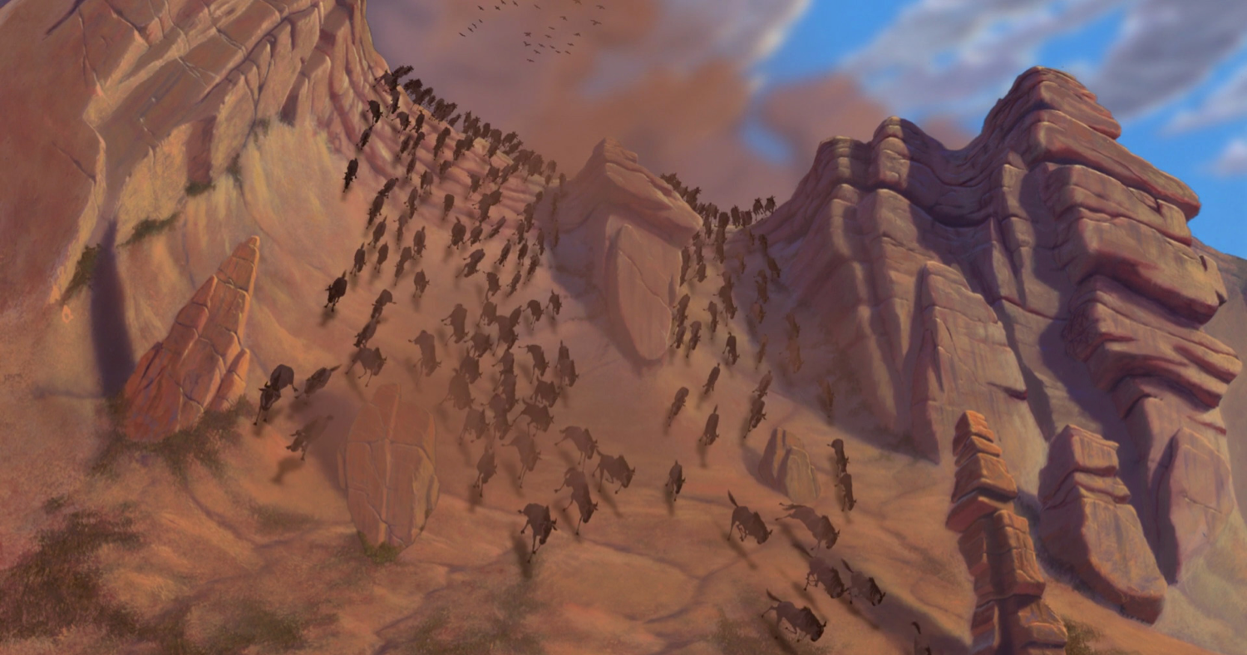
Cellular Automata
The Lion King, Disney Pictures 1994
Notes:
The technique that Craig Reynolds came up with was later applied and perfected in many other films and games.

Slide 7
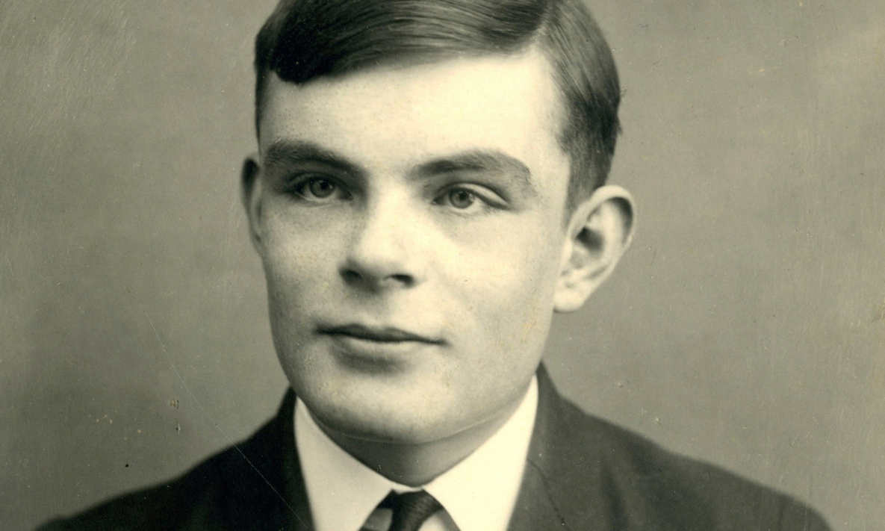

Slide 8
I propose to consider the question, "Can machines think?" This should begin with definitions of the meaning of the terms "machine" and "think."... But this is absurd. Instead of attempting such a definition I shall replace the question by another,
Turing, A.M.; Computing machinery and intelligence; 1950
Notes:
We can not just use the terms "thinking" and "intelligence" for machines and expect the definitions of those terms to remain useful. His second question was contained in "the imitation game”
http://www.loebner.net/Prizef/TuringArticle.html

Slide 9
Views on AI
Think like a person
Think optimally
Act like a person
Act optimally
Stuart Russell, Peter Norvig; Artificial Intelligence: A Modern Approach
Notes:
Thinking as a person can also be his thinking as a natural being

Slide 10
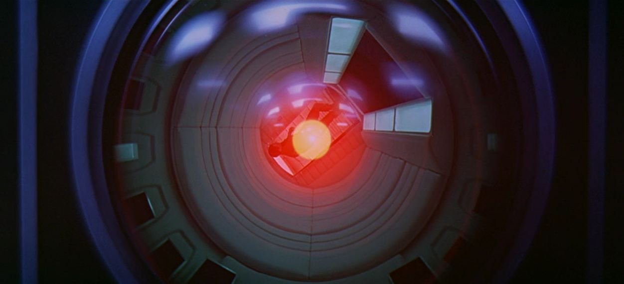
"The credibility of an artificial creature is based on the value we attribute to it"
Notes:
This is especially true with "acting as a human being" (see previous slide)

Slide 11
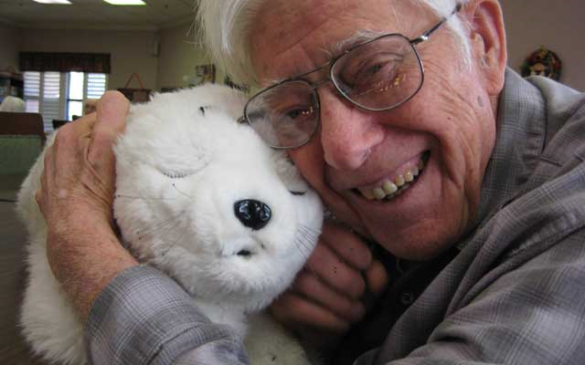
PARO: Artificial companion for the elderly
Notes:
https://www.youtube.com/watch?v=-fkxdFwu8yE

Slide 12
Affective Computing
“Computing that relates to, arises from, or deliberately influences emotions.”
Rosalind Picard
Emotion : Short duration, intense, focused on object or situation
Mood : Long duration, not intense, unfocussed
Affect : Abstraction of emotion and mood, expressed in
measurable values (eg PAD)

Slide 13
Why Affective Computing
Natural interaction with emotion.
Communication
Problem solving ability & decision making
Select and prepare actions
“We strive to interact with machines, not only operate them”
Notes:
The purpose of our emotion:
Communication
Problem solving ability & decision making
Select and prepare actions (fight or flight / rest and digest)
Emotions are control signals that adjust cognition and behavior in response to the environment.
for example, in a cheerful mood people are more exploratory, more flexible, less analytical and open to new things. The environment is safe [De Vries et al 2012].

Slide 14
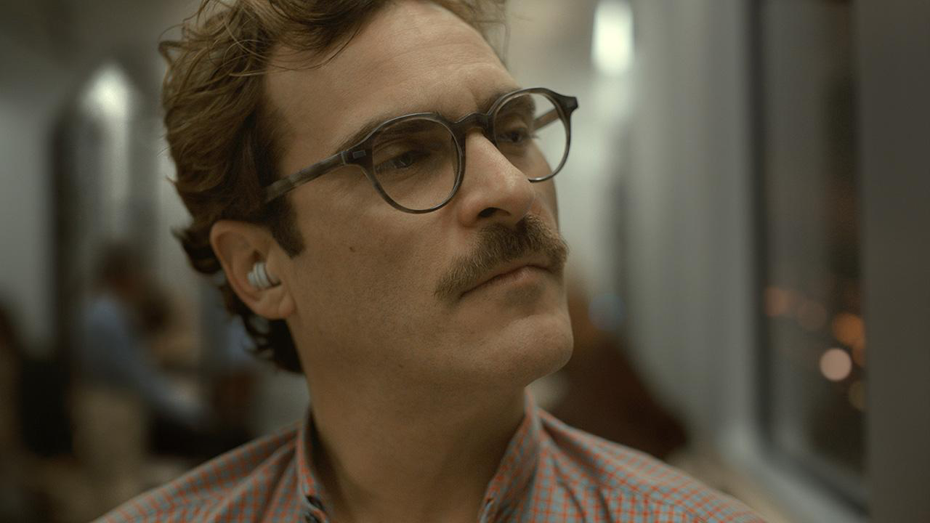
Her (2013)
Perceive Interpret Express
Notes:
Interpreting also involves influencing an internal state
Express is an expression of behavior that is also influenced by internal state

Slide 15
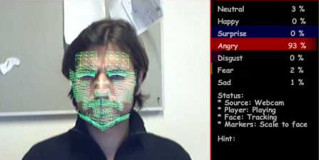
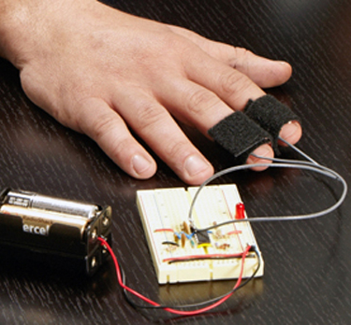
Perceiving Affect (implicit)
Implicit → Measuring
Behaviour
Facial expression
Posture
Movement
Intonation
Physiologically
Heart rate
Perspiration (GSR)
Breathing
Temperature
EEG
Notes:
http://makezine.com/projects/the-truth-meter-2/

Slide 16
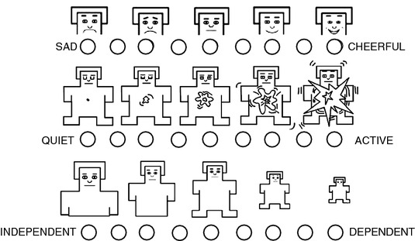
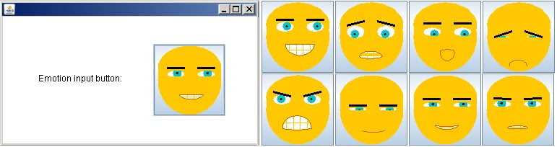
Perceiving Affect (explicit)
Explicit → Ask

Slide 17
Interpreting Affect
Three perspectives on emotional models:
Categories (Ekman 1972,Shaver 1987)
Components (Scherer 2001)
Dimensions (Russell 1980)
Notes:
Ekman (1972) states that an emotion consists of a specific combination of:
expression
feeling
behaviour
Physiology
Cheerful
happy expression
positive
explorative, play
Very exited
Sad
sad expression
negative
avoiding behaviour
little excited
Scherer (2001) stelt dat emoties het resultaat zijn van een aantal inschattingen/beoordelingen over een gebeurtenis of object in relatie tot je doelen, aannames en intenties. Cognitive appraisal theory

Slide 18
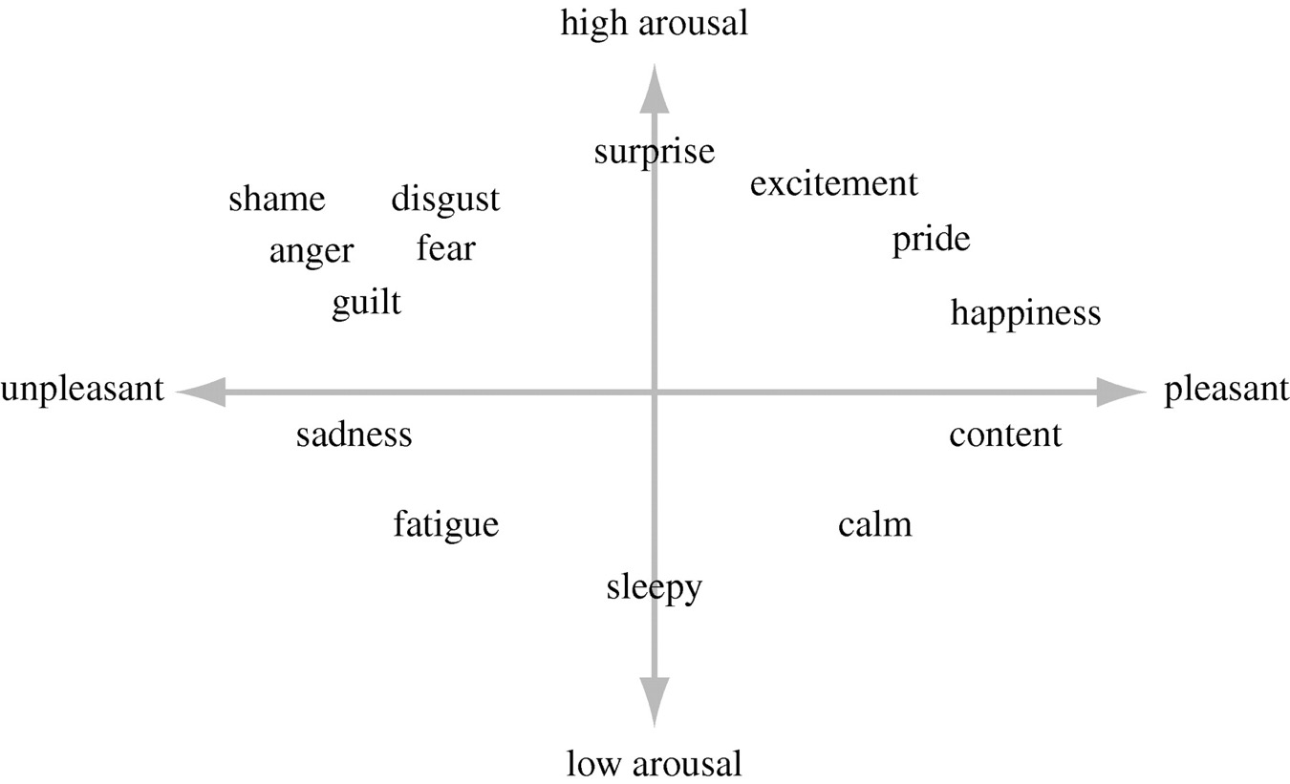
Russell (2003)
Later, the Dominance dimension was also added to this model
Notes:
These three states are on a continuous space:
Pleasant- unpleasant
arroused- Not arroused
Sense of Dominance - Sense of being dominated
The combination of and intensities on the different dimentions can be seen as an expression emotion.

Slide 19
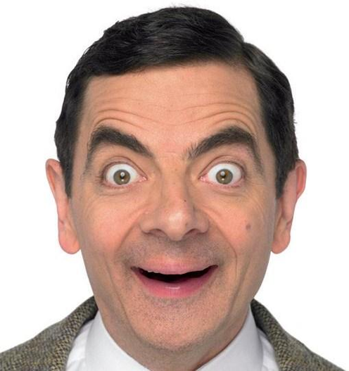
high arousal
unpleasant
pleasant
low arousal

Slide 20
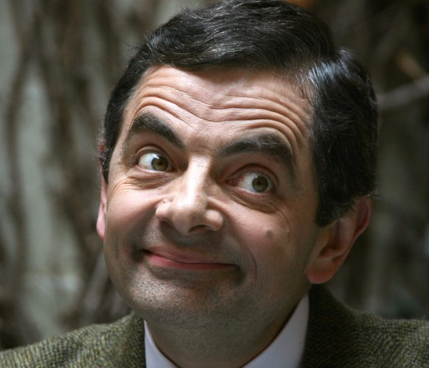
high arousal
unpleasant
pleasant
low arousal

Slide 21

high arousal
unpleasant
pleasant
low arousal

Slide 22

high arousal
unpleasant
pleasant
low arousal

Slide 23
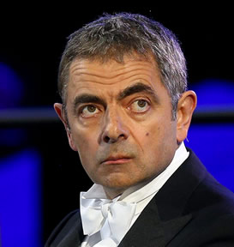
high arousal
unpleasant
pleasant
low arousal

Slide 24
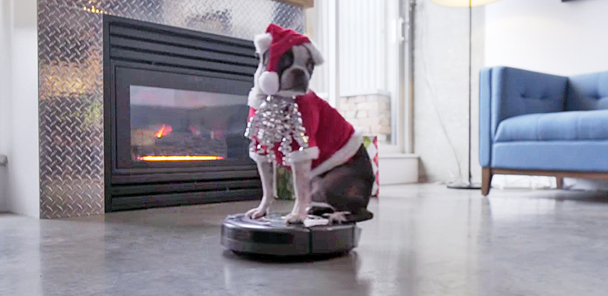
Intermezzo
Notes:
https://www.youtube.com/watch?v=J9P20HuX7mo

Slide 25
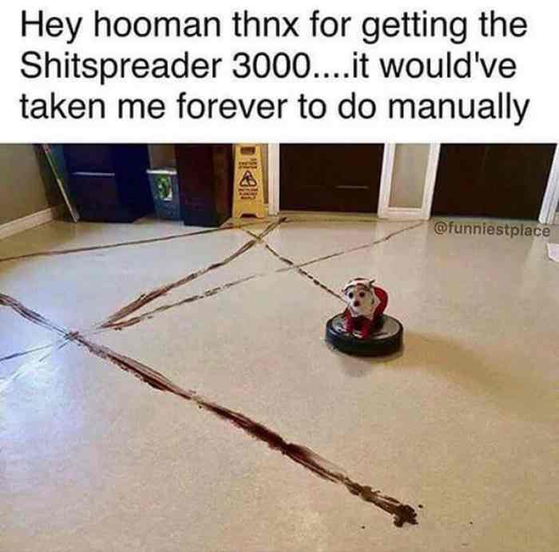
Break

Slide 26
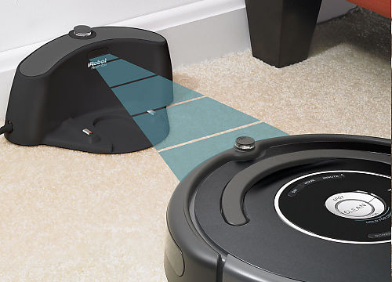
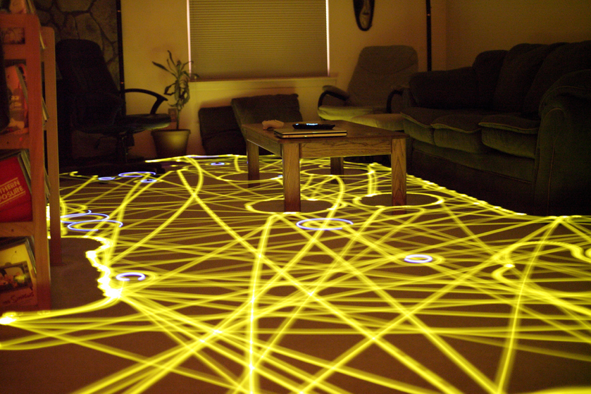
Synthetic Affect
Homeostasis model / needs model
iRobot Roomba, Rodney Brooks, 1990

Slide 27
Homeostasis model
Tendency to achieve an internal balance and maintain that balance
In humans, for example, hunger, temperature, hormones
Dust
Energy
Safety

Slide 28
Homeostasis model
Identify needs, have experiences
Actions and external factors influence internal state
Internal state influences behaviour
Balance between needs
Dust
Energy
Safety

Slide 29
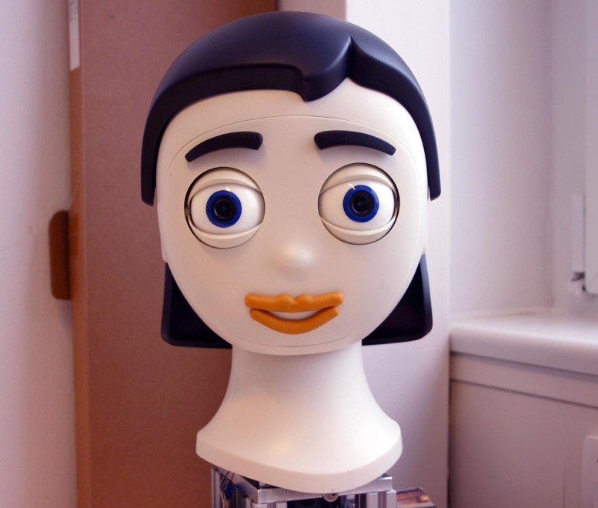
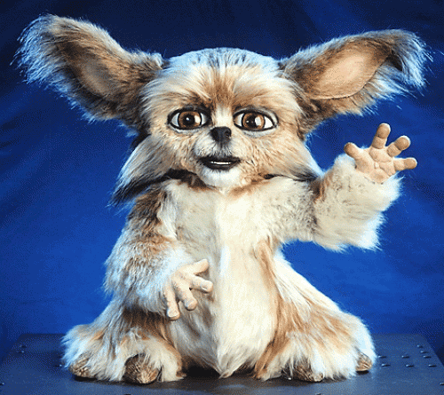
Expressing Emotion
Iconic
Realistic
Abstract
Notes:
Leonardo MIT Media Lab
https://www.youtube.com/watch?v=ilmDN2e_Flc

Slide 30
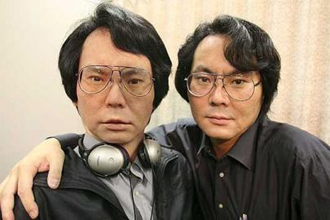
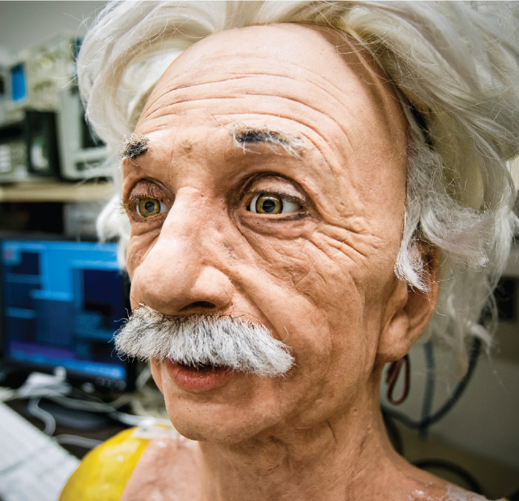
Expressing Emotion
Iconic
Realistic
Abstract
Notes:
Hiroshi Ishiguro
https://www.youtube.com/watch?v=uD1CdjlrTBM
http://www.youtube.com/embed/cy7xGwYdRk0
https://www.youtube.com/watch?v=C-rp75OO0sM
Einstein robot UCSD
https://www.youtube.com/watch?v=pkpWCu1k0ZI

Slide 31
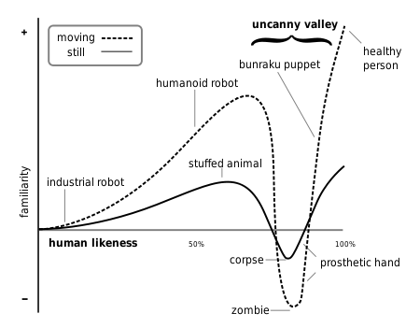
Expressing Emotion
Iconic
Realistic
Abstract
Notes:
Uncanny valley : Masahimo Mori.

Slide 32
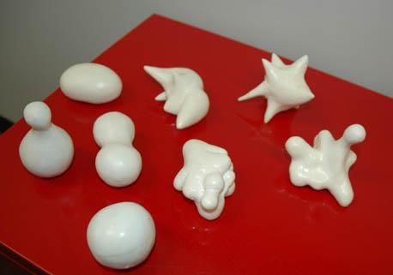
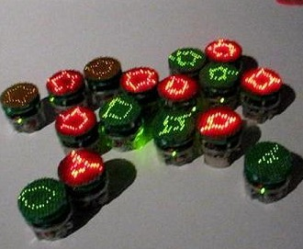
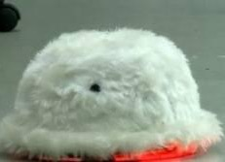
Expressing Emotion
Iconic
Realistic
Abstract
Notes:
The display of only the affective qualities without reference to humans (or something figurative at all)

Slide 33
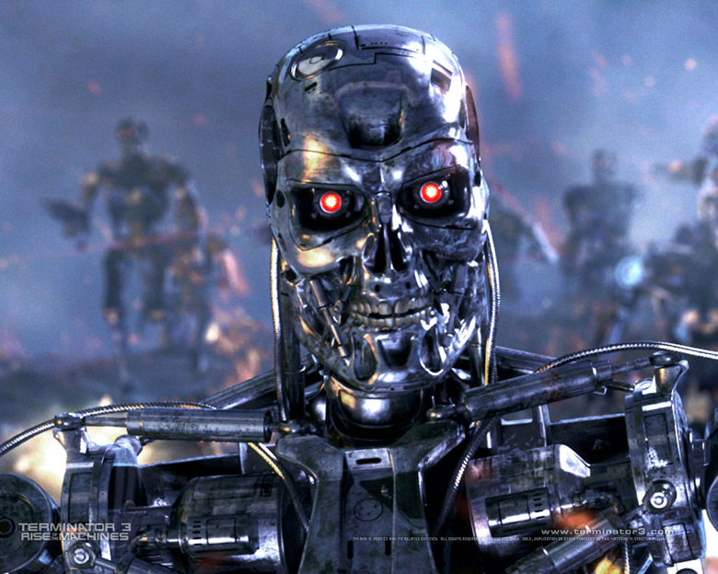
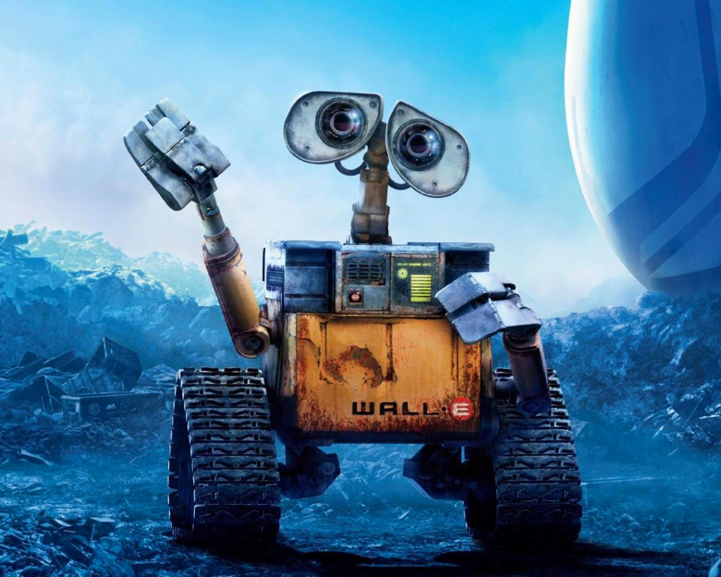
"The credibility of an artificial creature is based on the value we attribute to it"

Slide 34
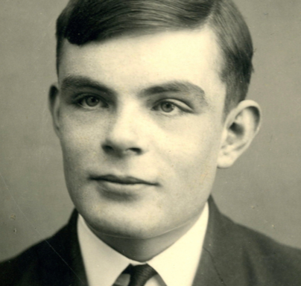
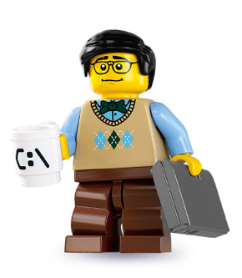

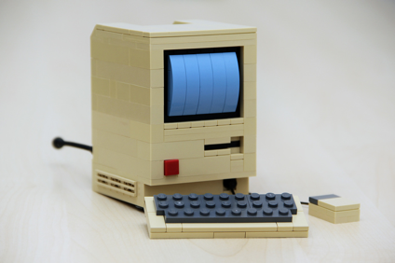
Alan Turing
Imitation game
Notes:
Thought experiment "the imitation game" by Alan Turing
Since 1990 the test is done under the name Loebner Prize. The maximum prize amount is $ 100,000. There is an obligation to make the code public.

Slide 35
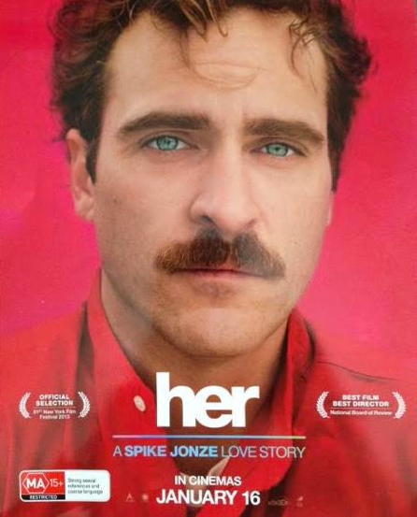
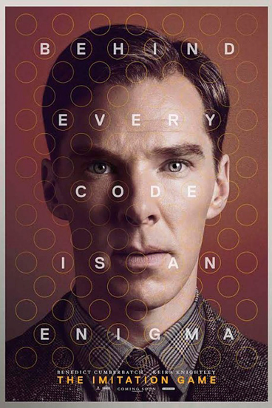
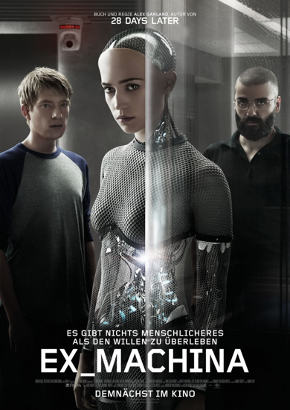
Films
Her
(2013)
The Imitation Game
(2014)
Ex Machina
(2015)

Slide 36
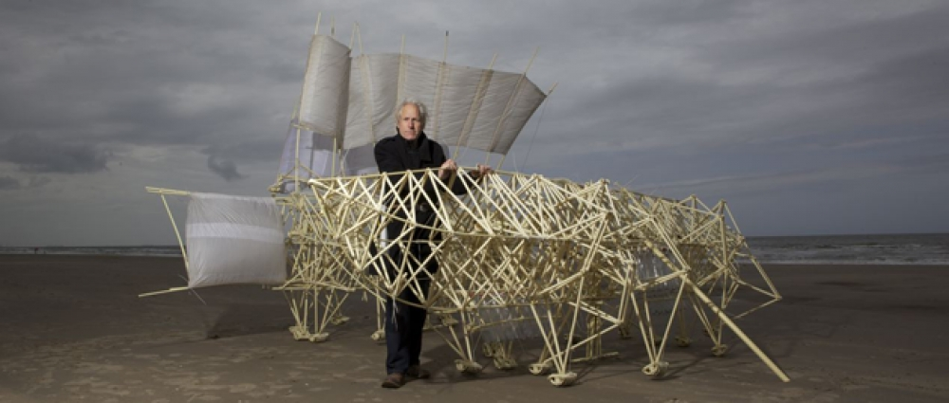
Strandbeesten; Theo Jansen; since 1990
Notes:
https://www.youtube.com/watch?v=HSKyHmjyrkA
https://www.youtube.com/watch?v=5N0IonPOy-I (lecture by Theo Jansen)

